Slide 1
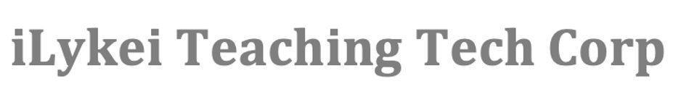

MScA 32015: Capstone II
Causation Inference with Probabilistic Models
Team Members: Chao Tang, Siyu Han, Zihao Liu, Yi Zhou
Professor: Don Patchell
Advisor: Ph.D.,Professor Yuri G Balasanov

Slide 2
Agenda
Team Profile
Background
Introduction
FemSmoke Exercise
Data Source and EDA
Methodology
Model Comparison
Application
Causal Discovery
Recommendations

Slide 3
Background
Business Partner: iLykei Teaching Tech Corp
Founder & President: Yuri G Balasanov
A cloud-based Learning Management System(LMS) for higher education that excels at providing core LMS features efficiently and effectively
Opportunity Statement
To apply Bayesian technique for making causation inference based on Probabilistic Models
To understand which variables are causally related and possible confounders to identify the amount of causation effect
Business Goal
To bring a significant education for the Bayesian Network knowledge
To provide a lifestyle recommendation for people’s health and well-being in the real world
Notes:
A technique for making inferences about causation, that has become very popular recently but is still not known enough within the Data Science community is based on Probabilistic Models.
The team working on the project will learn necessary probabilistic models and apply them to two datasets (“FemSmoke” and “Diabetes_012”) to understand what portion of the observed correlation, if any, can be associated with causation.
Understanding which variables are causally related and are possible confounders, and also the amount of causation effect.

Slide 4
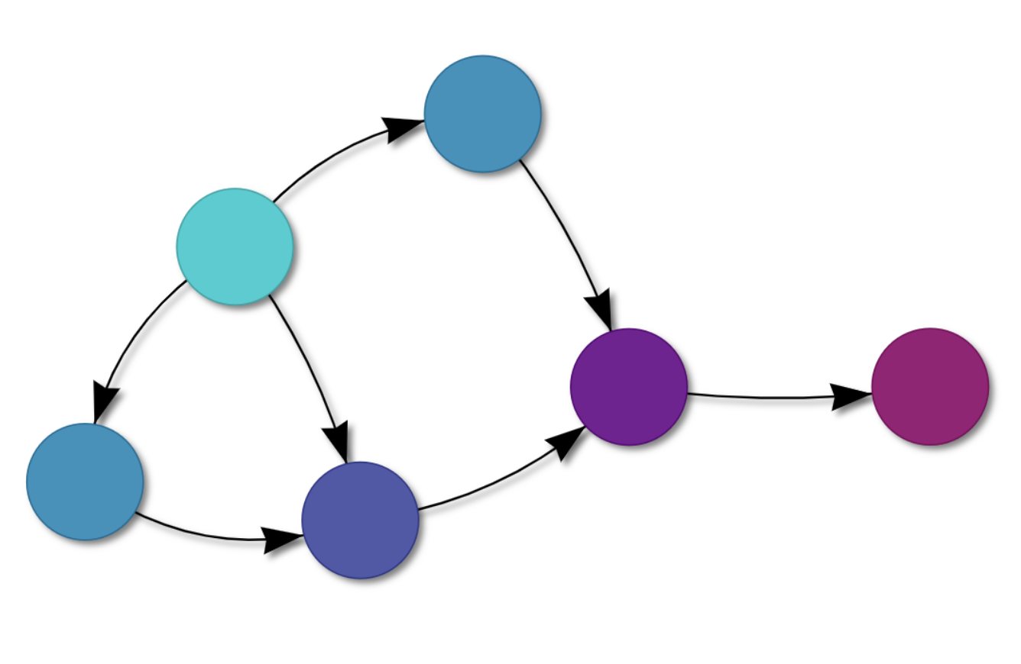
Introduction
Bayesian Network : A probabilistic graphical model that represents knowledge about causal probability relationships where each node corresponds to a random variable and each edge represents the conditional probability for that corresponding random variables
AgenaRisk : A Bayesian Network Software to model a variety of problems to make predictions, perform diagnostics and make decisions by combining data and knowledge about complex causal and other dependencies in the real world
Notes:
You can use AgenaRisk models to make predictions, perform diagnostics and make decisions by combining data and knowledge about complex causal and other dependencies in the real world. AGENARISK uses the latest developments from the field of Bayesian artificial intelligence and probabilistic reasoning to model complex, risky problems and improve how decisions are made.AgenaRisk can be used to model a variety of problems involving risk and uncertainty including operational risk, actuarial analysis, intelligence analysis risk, systems safety and reliability, health risk, cyber-security risk and strategic financial planning

Slide 5
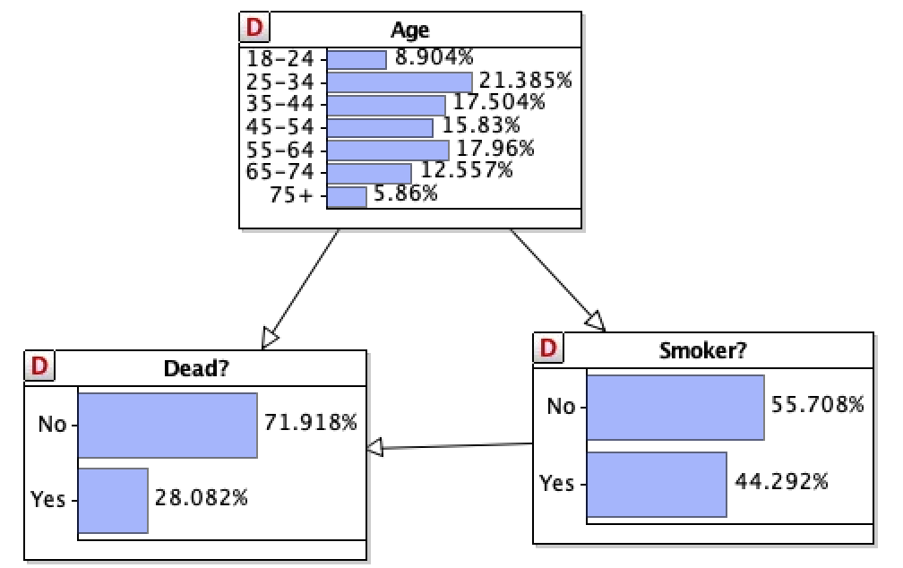
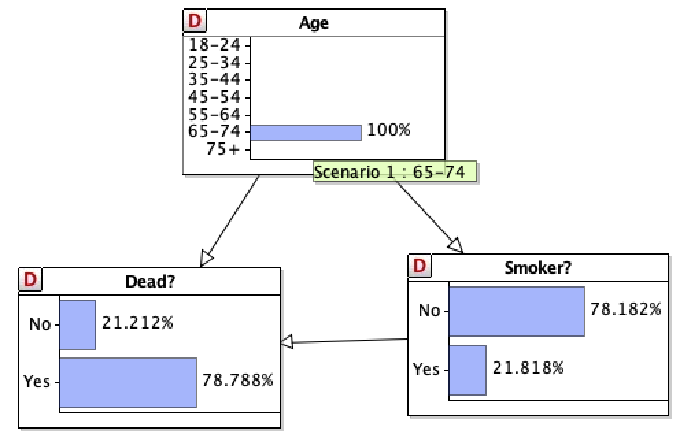
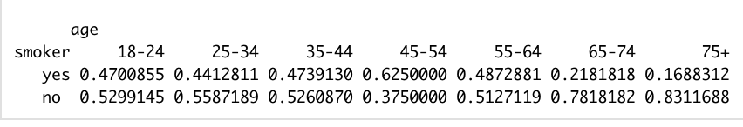
FemSmoke - Exercise
Dataset: Femsmoke ®
Main Variables
y: Target variable with the number of observed count for given combination
smoker : Yes/No level smoker
dead : Yes/No level
age: age-group levels
Objective: define the causal relationship between death, smoking and age.
Distribution table of ‘Smoker’ in 7 groups of age
By setting the scenario ( Age = 65-74) in AgenaRisk, the conditional probabilities of corresponding variables “Dead” and “Smoker” changed.

Slide 6
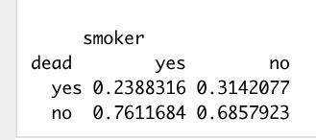
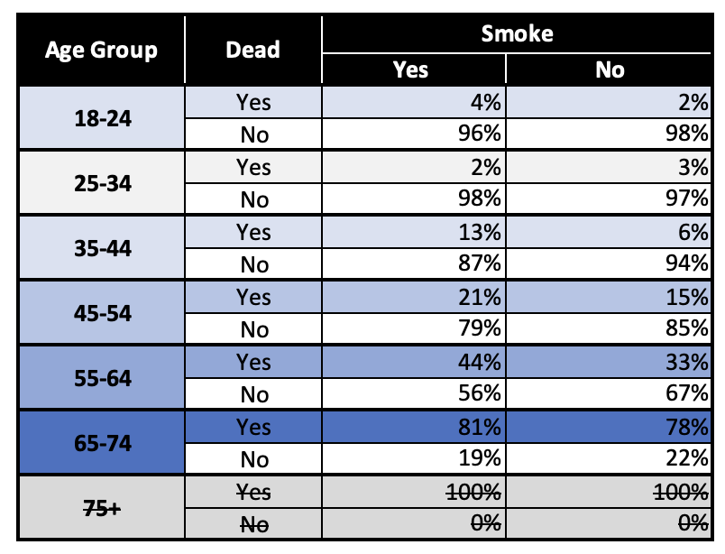
FemSmoke - Exercise
Probability Table without “Age”
Simpson’s Paradox: When we compare death and smoke, we find that people who smoke have a lower rate of death. But in every age group, we find that people who smoke have a higher rate of death.
Why? Age is a confounder. Young people smoke more than old people. Young people are less likely to die after 20 years.
Probability Table with “Age”Group
Notes:
We use …. In class for illustration how to do …….(so ppl know its not the main work)

Slide 7
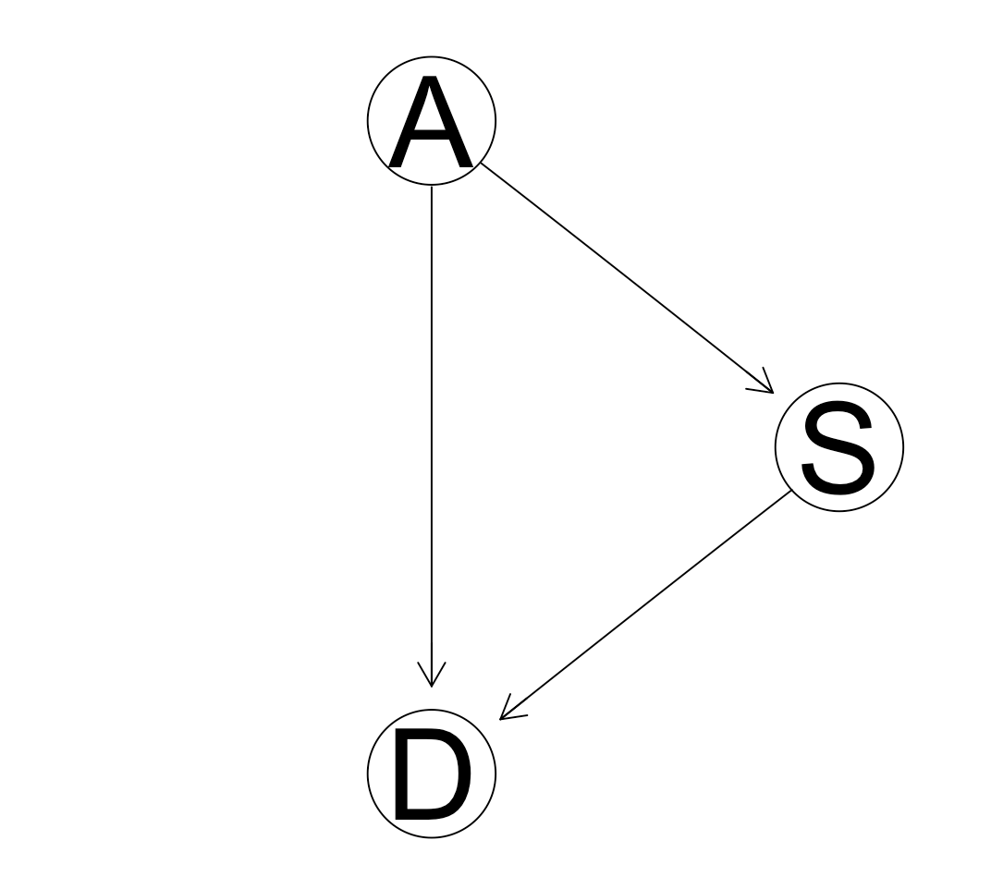
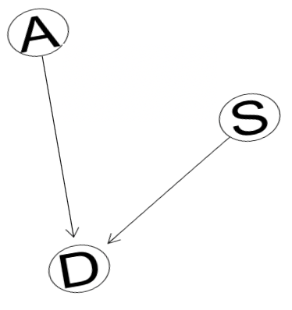
FemSmoke - Causal Inference
Mutilation
Smoke CAUSES death to increase 5%
Dr. Pearl’s method:
Mutilation: Block information flow from confounding variables to treatment
Stimulation: Use Monte Carlo to sample two status of treatment to estimate probabilities
ATE(Average Treatment Effect) = P(D=1|do(S=1))-P(D=1|do(S=0)) = 0.05
A：Age
S：Smoker
D：Dead
Notes:
Expand, explain +++
BN three random variables(explain), arrows, explain each variable,
+two diagrams(S+D, S+A+D)
In order to find causation, we need to apply techniques
smoker&nonsmoker: death rate…
This BN represents the joint distribution of all three variables and it allows play scenarios, we can see how the p changes with the conditions(variables) sets. If we have evidence of one of the variables, bn shows how the distribution of other variables changes.
Technique by pearl, graph mutilation, … opposite result
smoker/non-smoker, death rate is negative, death rate goes up when you move to non-smoker (positive number)

Slide 8
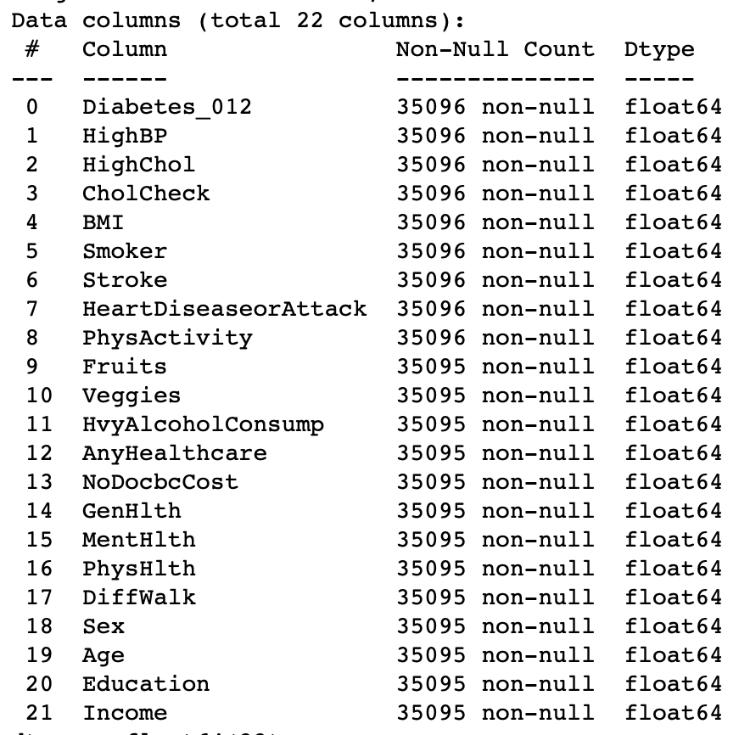
Data Source
Diabetes_012 is a clean dataset comprising of 253,680 survey responses from the CDC’s data source BRFSS2015.
Target Variable | Diabetes_012 | 0: No Diabetes 1: Pre Diabetes 2: Diabetes
 | HighBP | 0: no, 1: yes
 | Stroke | 0: no, 1: yes
 | HeartDiseaseorAttack | 0: no, 1: yes
Missing value: 0
Date Type: 91% categorical, 9% numerical
Notes:
Apply this technique to data of our project , …
Explain variables,

Slide 9
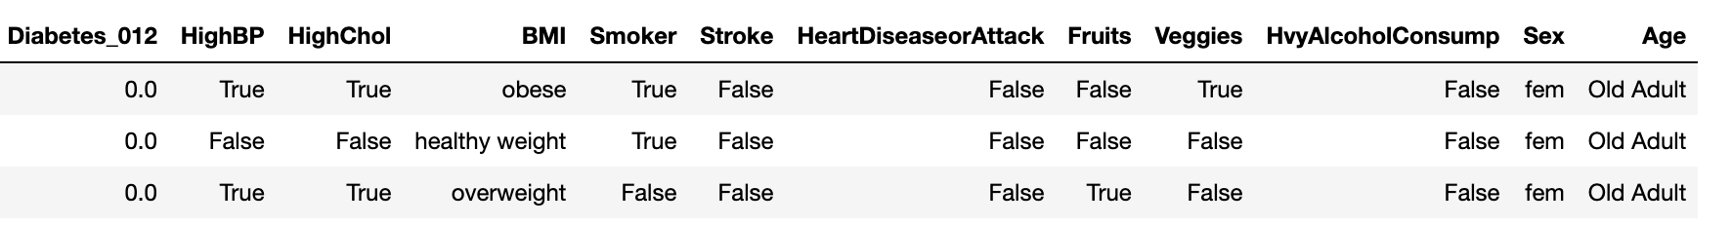
Feature Engineering
Continuous Variables
Age：'Young Adult', 'Mid Adult', 'Old Adult',"Senior"
BMI：['underweight', 'healthy weight', 'overweight',"obese"]
Categorical variables
Transfer necessary variables into booleans
Notes:
Cut time explaining

Slide 10
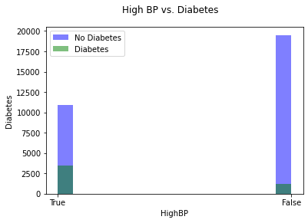
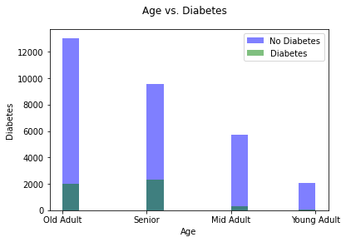
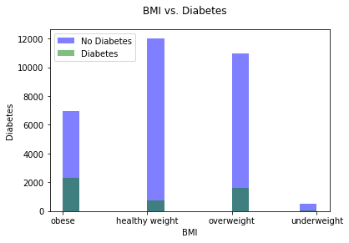
Exploratory Data Analysis (EDA)
We have to deal with unbalanced data
Notes:
Descriptive Analysis (EDA)(no more 15 seconds)
Histogram
Mention: we have to deal with unbalanced data( we dont have enough data that have diabetes)

Slide 11
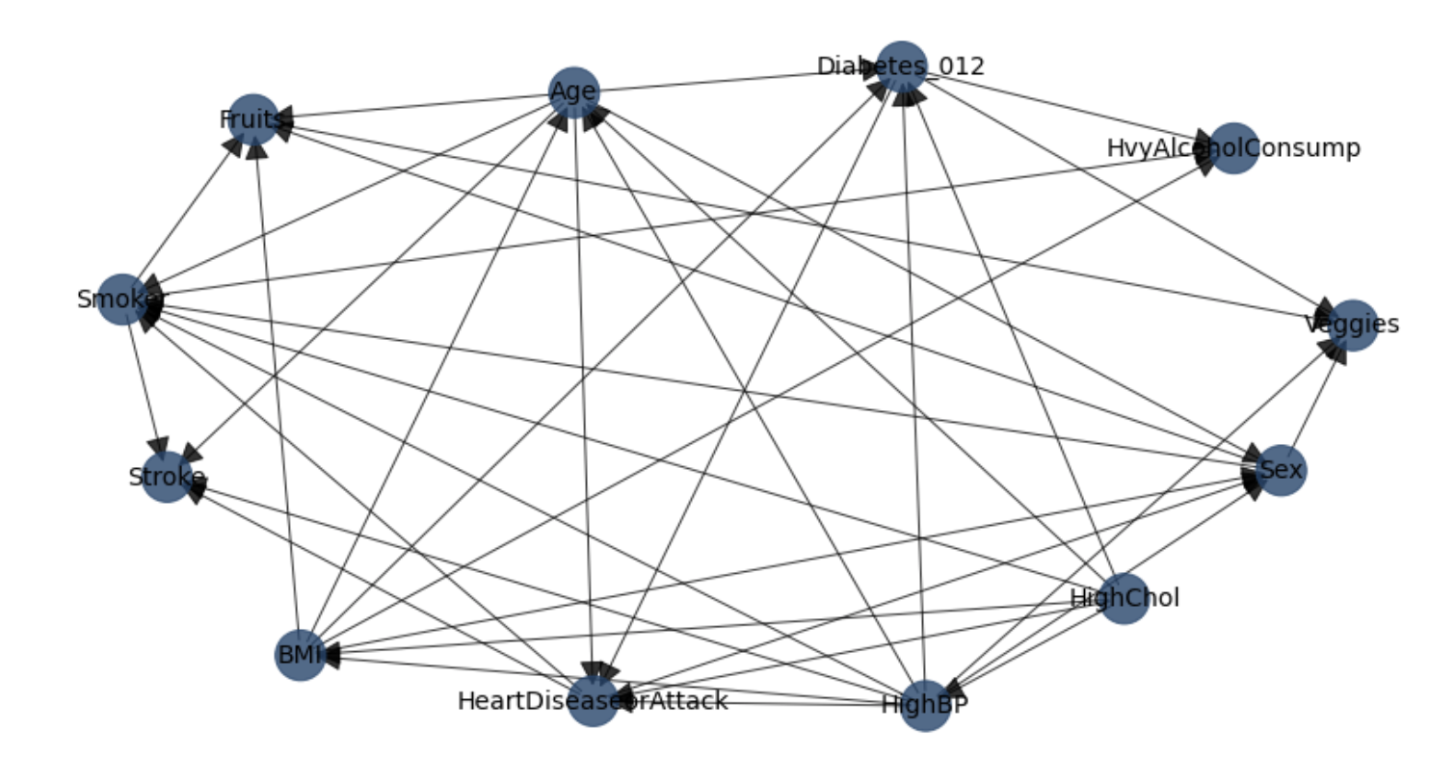
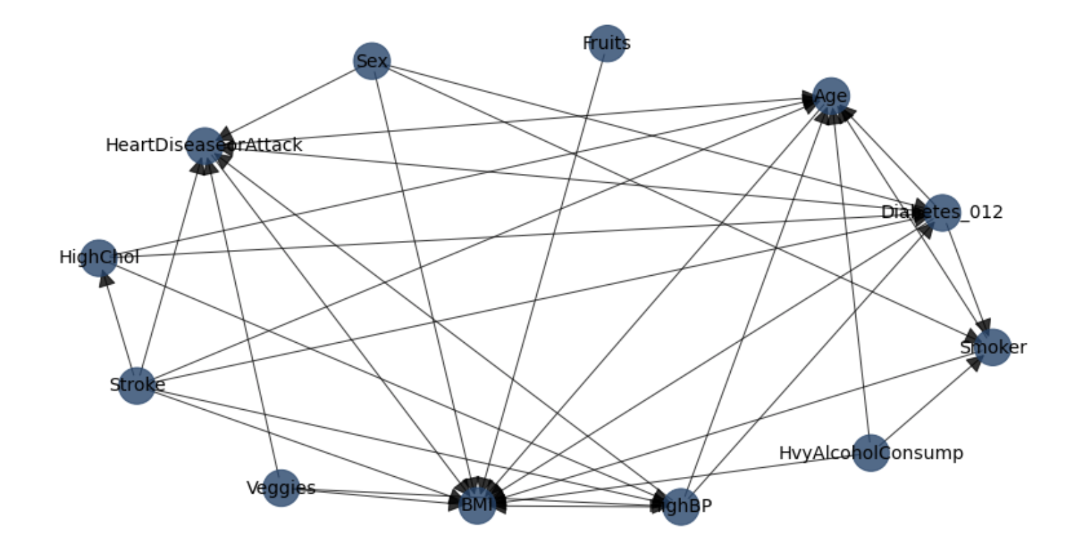
Methodology
Hillclimbsearch Method - Selected Final Model
Parameter Constraints Method
HC and PC have similar Structure but HC is less time consuming
Notes:
Quick Slide: Explain differences between estimated diagrams, … edge missing/not(maybe highlight some)
One example of one difference connections

Slide 12
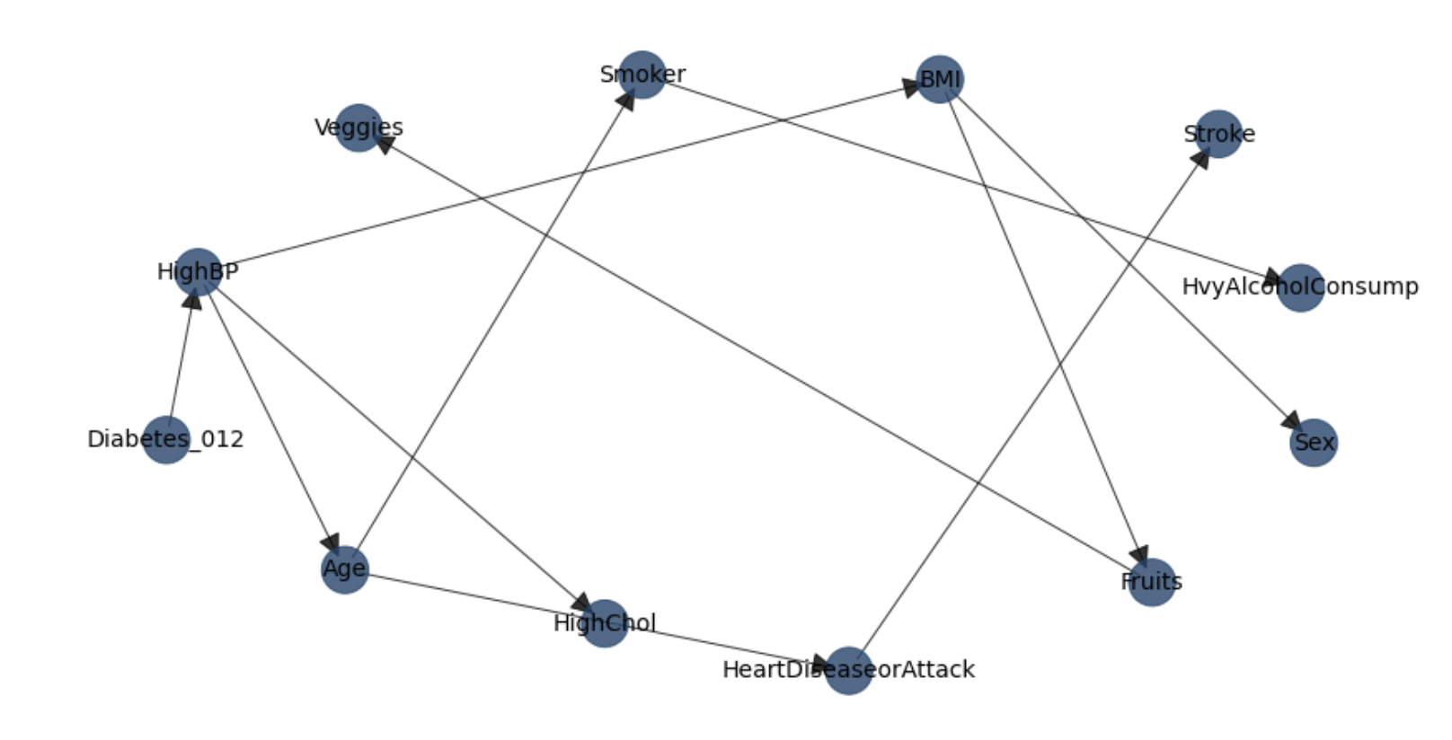
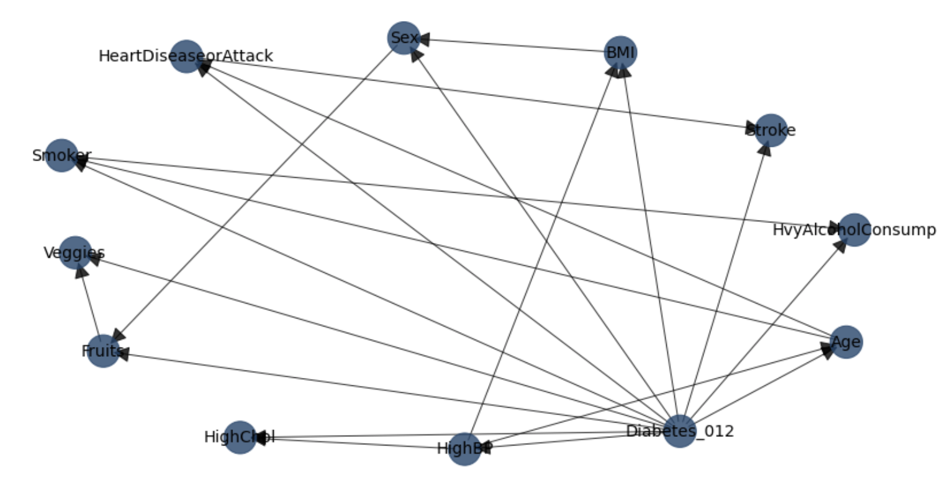
Methodology
Chow-Liu Method
Tree-Augmented Naive Bayes Method
Naive Bayes is a well-known binary classification model. Its target variable causes other factors. We use this to do independent test
CL is an estimation methods. Since there are not many nodes connected with each other, we are lean to other structures
Notes:
Quick Slide

Slide 13
Model Comparison
 | MODEL | ACCURACY
1 | Hillclimbsearch | 0.8605329549038159
2 | Tree-Augmented Naive Bayes (tan) | 0.8557040365815201
3 | Chow Liu | 0.8593306527909177
4 | Parameter Constraints Method | 0.8591168091168091
Hillclimbsearch is the final chosen model with the highest accuracy.

Slide 14
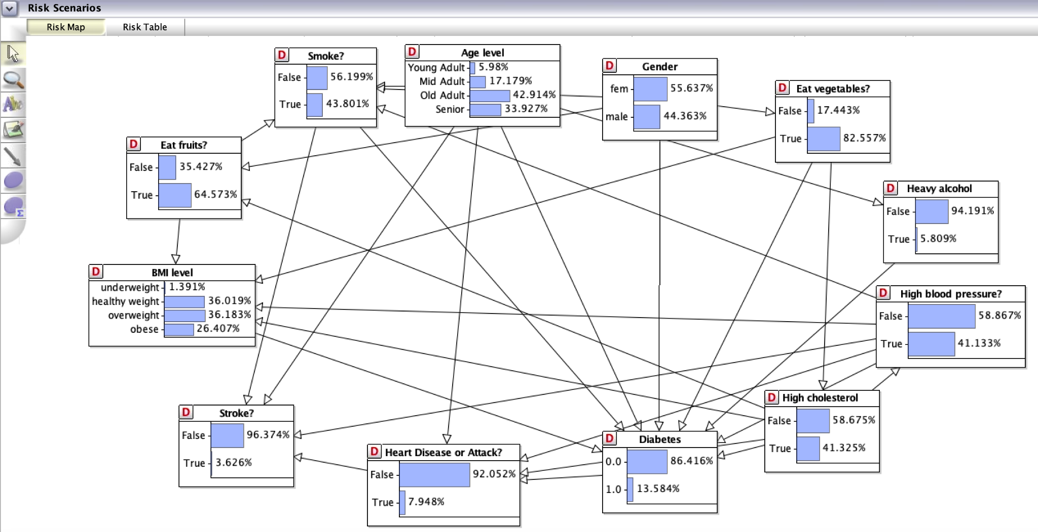
Application - Bayesian Networks in AgenaRisk
Demo:
A young female adult goes to the clinic.
Suppose I am the doctor and would like to use AgenaRisk to show the patient how her health conditions will change in her lifespan according to different lifestyles/habits.
Notes:
Results - HC diagram of the AgenaRisk
Storyteller of the application of hc in agenarisk by applying different scenarios
Explain what we do
Storyline: disease prevention, strategy recommendation,
Life style recommendation based on the hc model in agenarisk
interactive tab, agenarisk display

Slide 15
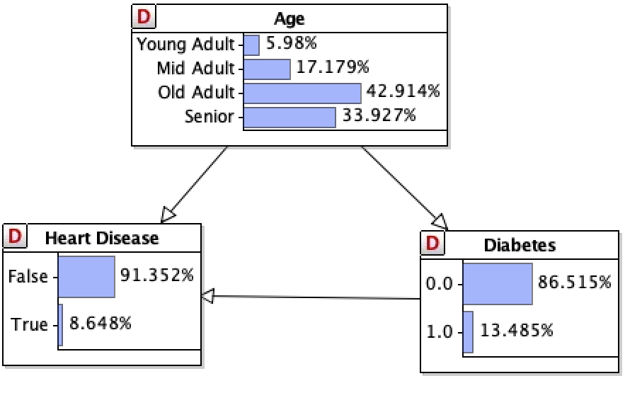
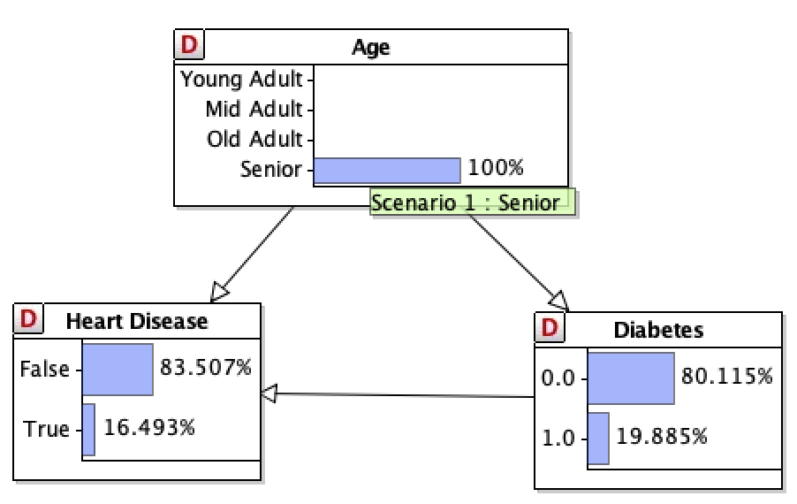
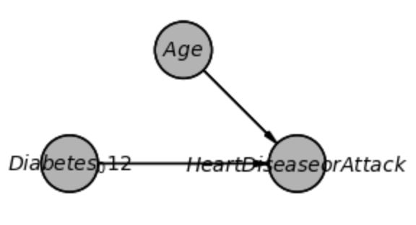
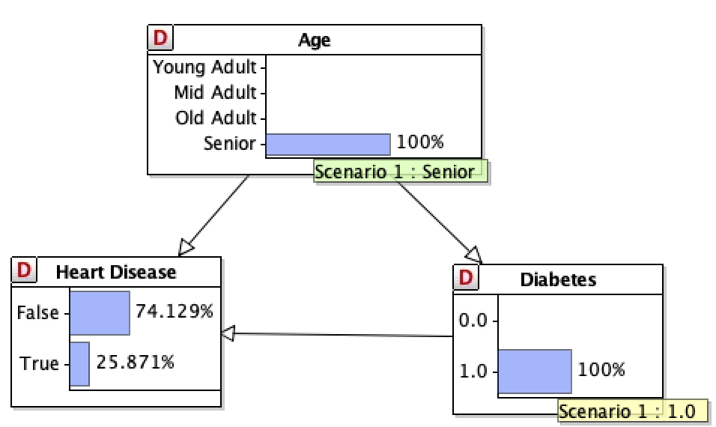
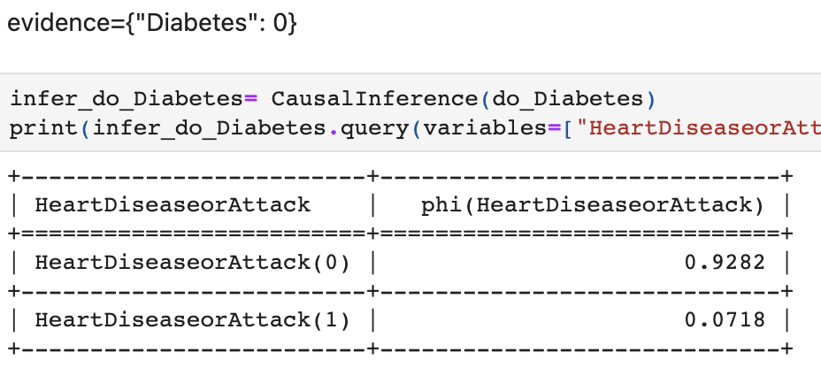
Causal Discovery
Confounder: Age
Senior Diabetes patients have a higher rate of Heart Disease than other younger and non diabetes patient
Age can influence both Diabetes and Heart Disease
Heart Disease increases as age goes up with higher rate of Diabetes
Remove the dependence of selection for Diabetes on Age
 | "Diabetes": 0 | "Diabetes": 1
HeartDiseaseorAttack(0) | 0.9282 | 0.8343
HeartDiseaseorAttack(1) | 0.0718 | 0.1657
Calculate the causal effect as Average Treatment Effect (ATE) = 0.1064117111222927
Notes:
Removing dependence of selection for treatment on age. The initial unconditional distribution of "Age" remains unchanged, of course. Other unconditional distributions, except for the node "Diabetes_012" are also the same.

Slide 16







Recommendation / Future Work
Because of dataset’s class imbalance, our research on simpson’s paradox is limited. In the future, we would consider approaches to balance the data.
Incorporate more variables in the dataset to make the network more powerful. For example, by adding more symptoms, we could use the network for disease diagnosis. Therefore, BNs have more business impact in the industry.
Compared with blackbox models, Bayesian Networks can provide both good predictions and insights from model.
Bayesian Network can be implemented for risk management.

Slide 17
THANK YOU — Q&A —
Notes:
Thank MScA program to organize and support the team
Thank Don to lead the classes all the way from Capstone I to Capstone II.
Thank
Thank you notes to Don/MScA Program/Yuri/Students/ all participants.

Slide 18
Reference
Link of our recording
Balasanov, Y. (n.d.). About iLykei. iLykei. Retrieved April 9, 2022, from https://www.ilykei.com/about
Fenton, N. E., & Neil, M. (2019). Risk assessment and decision analysis with Bayesian Networks. CRC Press, Taylor & Francis Group.
Pearl, J., & Mackenzie, D. (2020). The book of why: The new science of cause and effect. Basic Books.
Yang,X. (2019). Introduction to Algorithms for Data Mining and Machine Learning.
Wikimedia Foundation. (2021, December 22). Randomized controlled trial. Wikipedia. Retrieved May 1, 2022, from https://en.wikipedia.org/wiki/Randomized_controlled_trial
Wikimedia Foundation. (2022, March 30). Natural experiment. Wikipedia. Retrieved May 1, 2022, from https://en.wikipedia.org/wiki/Natural_experiment#:~:text=A%20natural%20experiment%20is%20an,exposures%20arguably%20resembles%20random%20assignment.
Alexteboul. (2022, March 10). Diabetes health indicators dataset notebook. Kaggle. Retrieved October 12, 2022, from https://www.kaggle.com/code/alexteboul/diabetes-health-indicators-dataset-notebook

Slide 19
Appendix-Literature Review
Fenton, N. E., & Neil, M. (2019). Risk assessment and decision analysis with Bayesian Networks. CRC Press, Taylor & Francis Group.
Pearl, J., & Mackenzie, D. (2020). The book of why: The new science of cause and effect. Basic Books.

